Slide 1
Making Kubectl PowerShell Friendly
The PoSh Wolf
https://github.com/theposhwolf/sessions

Slide 2
Who is The PoSh Wolf?
Anthony Howell
From Eugene, OR USA so, according to ChatGPT, I am:
Progressive, outdoorsy, creative, friendly, and open-minded
~3.3 kids, 2 dogs, 1 wife, 1 cat
In IT since 2011
Blogger (https://theposhwolf.com)
Twitter (https://twitter.com/theposhwolf)
Pluralsight author (https://pluralsight.com)
Consulting (https://howell-it.com)
Employed (Cloud Platform Architect)

Slide 3
Overview
What is the problem?
Why not Crescendo or -o json?
Technical solution
Parsing output
Generating PowerShell formats
Reducing reliance on Where-Object (Filtering Left)

Slide 4
CAUTION: Opinion ahead

Slide 5
The Problem
Kubectl is just stdout

Slide 6
Crescendo or -o json?
Crescendo
Definitely more PowerShell-y (verb-noun)
Not cross-shell compatible
Not a bad tool, just not the right tool for the job
kubectl get pod -o json | ConvertFrom-Json
Too much typing
Too much data, usually

Slide 7
Solution Requirements
Reliably and efficiently parse Kubectl output
Preserve syntax
Maintain Kubectl’s table output format

Slide 8
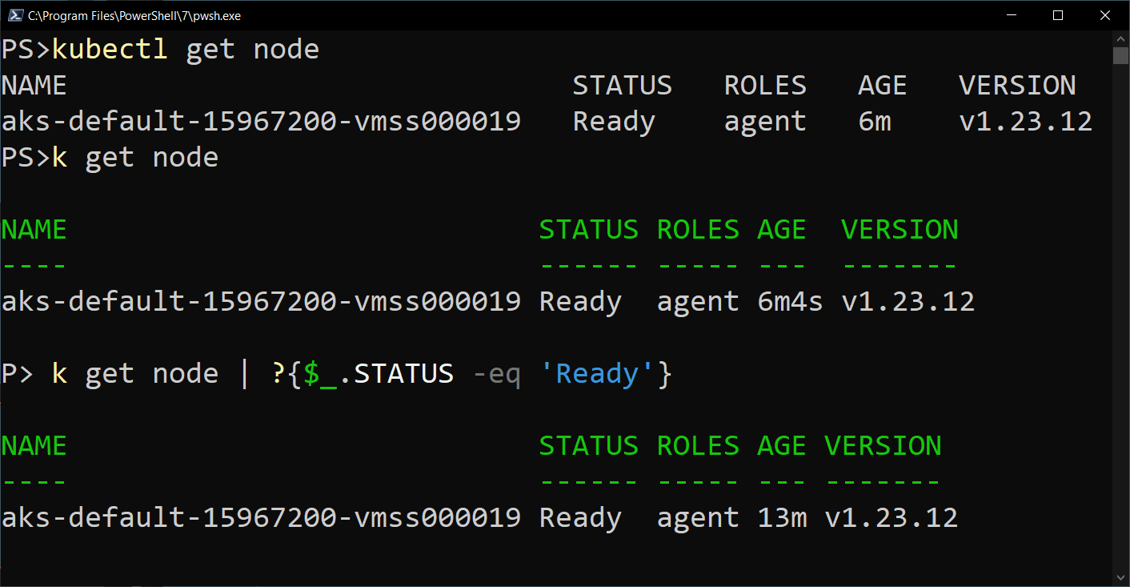
My Solution

Slide 9
Prerequisites
PowerShell
Kubectl

Slide 10
Demo Environment
Windows 10
VS Code (latest version)
PowerShell 7.3.3
specialK
Kubectl

Slide 11
Parsing

Slide 12
Process
Use headers to calculate spacing indexes
Insert semicolons
ConvertFrom-CSV –Delimiter ‘;’
Insert type name (for format)

Slide 13
NAME READY STATUS RESTARTS AGE
database-deployment-194a92db12-b2aat 1/1 Running 0 10d
web-deployment-98ad9380dd-8brg3 1/1 Running 0 2d7h

Slide 14
NAME ;READY ;STATUS ;RESTARTS ;AGE
database-deployment-194a92db12-b2aat ;1/1 ;Running ;0 ;10d
web-deployment-98ad9380dd-8brg3 ;1/1 ;Running ;0 ;2d7h

Slide 15
NAME;READY;STATUS;RESTARTS;AGE
database-deployment-194a92db12-b2aat;1/1;Running;0;10d
web-deployment-98ad9380dd-8brg3;1/1;Running;0;2d7h

Slide 16
Formats

Slide 17
Filtering Left

